Slide 1
Course: Application of ICT
Course Code: CS-117
Credit Hours: 2+1
Session 1
Instructor: Lecturer Laraib
Instructor: Lecturer Laraib Zainb

Slide 2
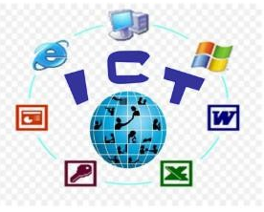
Introduction to ICT
Definition: ICT stands for Information and Communication Technology. It means using technology to access, store, share, and communicate information. Examples include computers, mobile phones, the internet, and cloud services.
Importance: ICT is important because it helps us in communication, education, business, and entertainment.
1

Slide 3
Data versus Information
Data: Raw plain facts
Information: When data is Processed and Organized to make it Useful.
e.g. 26 51 47 29 33
2

Slide 4
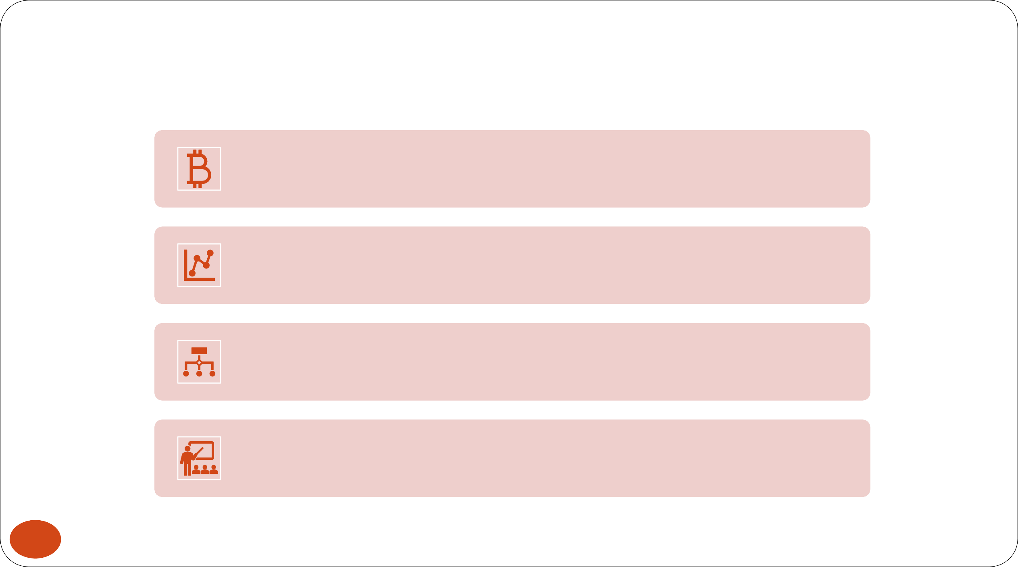
Data And Information
Data is raw, unorganized facts that need to be processed. Data
can be something simple and useless until it is organized.
Example: Each student's test score is one piece of data.
When data is processed, organized, structured or presented in a given context so as to make it useful, it is called information.
Example: The average score of a class or of the entire school is information that can be derived from the given data.
3

Slide 5
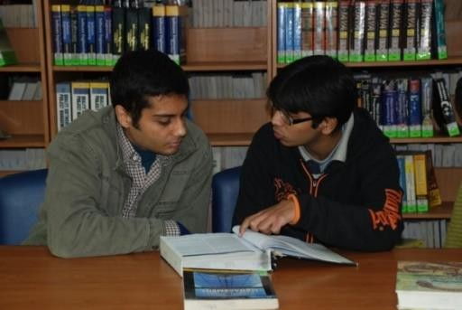


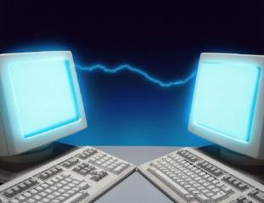
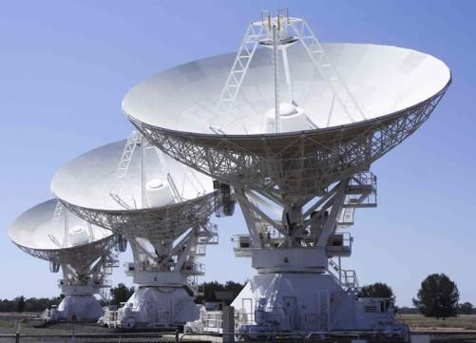
Communication
Communication: Communication is the process of sending information from a sender to a receiver using a medium.
For ICT, we mainly use electronic media such as TV, radio, internet, email, social media, mobile phones, and instant messaging.
4

Slide 6

Technology
ICT is a collection of technologies and tools used to communicate, create, store, share, and manage information.
These technologies include computers, the Internet, radio, television, and mobile phones.
The computer is still an important part of ICT because it helps us process, store, and share information.
5

Slide 7
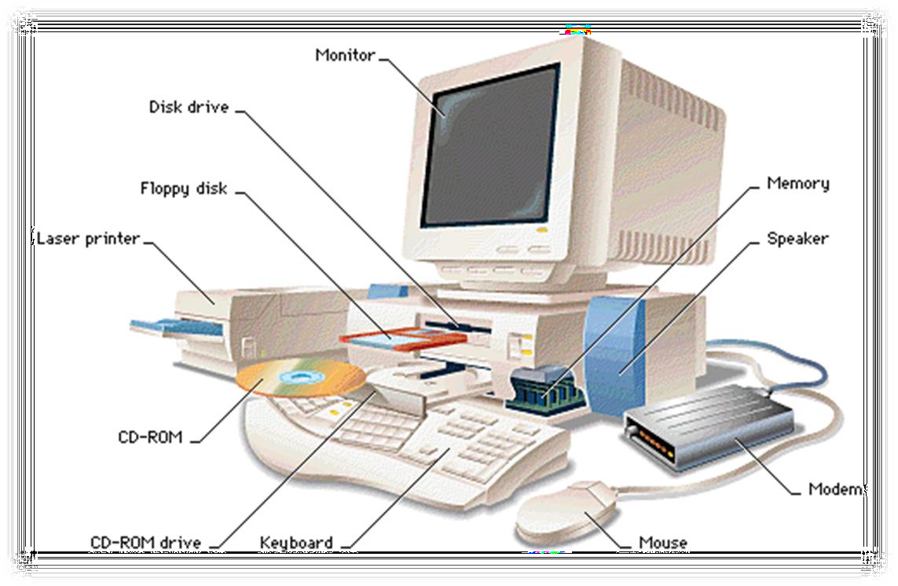
What is a Computer?
What are they good at?
What type of problems are not suitable for computers?
Can computers think?
6
Notes:
Computers are good at calculating, storing information, processing data, and doing repetitive tasks quickly and accurately.
Problems that require human feelings, emotions, creativity, or personal judgment are not always suitable for computers.
Computers cannot think like humans. They follow instructions and process information according to their programming.

Slide 8
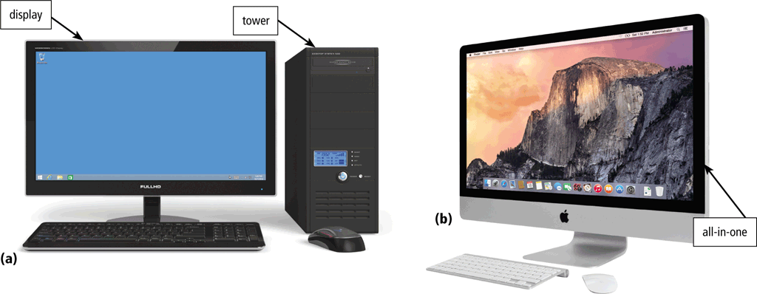
The Computer Defined
“A Computer is a machine that can be programmed to accept data, process data into useful information and store it for later use.”
Processing
Input
Output
7
Notes:
Simple example: You enter marks → the computer calculates the total → shows the result → saves it.

Slide 9
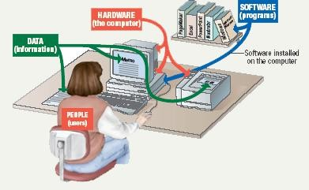
Parts of the Computer System
Computer systems have four parts
–Hardware
–Software
–Data
–User
8

Slide 10
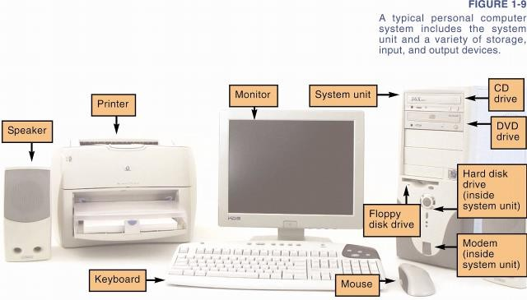
Parts of a Computer - Hardware
Different components of computer are as follows:
9

Slide 11

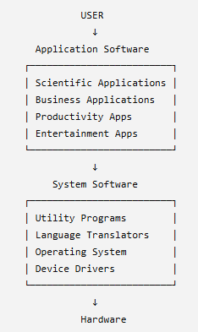
Layered Architecture of Computer System – (Hardware & Software)
Hardware
Device Driver
Operating System
_{Utility} Language Scientific Business Productivity Entertainment Translator Apps. Apps. Apps. Apps.
System software
Application software
11
Notes:
Hardware: The physical parts of the computer that we can touch, such as the keyboard, monitor, and CPU.
Operating System: Software that controls the hardware and allows other programs to work. Examples are Windows, Linux, and macOS.
System Software: Helps the computer and hardware work properly. It includes the Operating System, Device Drivers, Utility Programs, and Language Translators.
Application Software: Programs that help users perform specific tasks, such as business apps, scientific apps, productivity apps, and entertainment apps.
Application Software vs. System Software: System software (like operating systems) manages and runs the computer's hardware. Application software consists of programs designed for users to perform specific tasks.

Slide 12
System Software
Control the overall operation of computer
Interact directly with hardware
Perform system management and maintenance
Used to develop or maintain other programs
12

Slide 13
Application Software
Interact directly with the user
Perform a certain type of task
Interact with hardware through system software
13

Slide 14
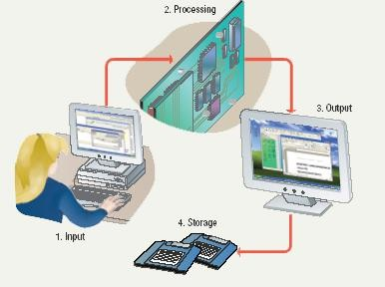
Information Processing Cycle
Steps followed to process data
Input
Processing
Output
Storage
14

